Slide 1
Global Superstore Business Performance Dashboard
By: Priyadarshini Gupta
Date: 11/19/2025

Slide 2
Executive Summary
This dashboard provides a comprehensive view of sales, profitability, customer behavior, and product performance for Global Superstore from 2011 to 2014.
The goal is to support data-driven decision-making using interactive and time-based insights.
Analysis covers multiple years of sales transactions from the Global_Superstore2 dataset.

Slide 3
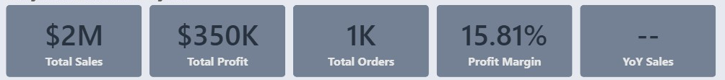
Key Metrics
Performance indicators include:
  Total Sales
  Total Profit
  Total Orders
  Profit Margin
  YoY Sales % (Year-over-Year)
    The calculations are done to show YoY sales % for a selected year and not total.
    2012: 5.44%
    2013: 16.71%
    2014: 6.90%
These KPIs remain visible across all pages to offer instant, consistent visibility into business health.

Slide 4
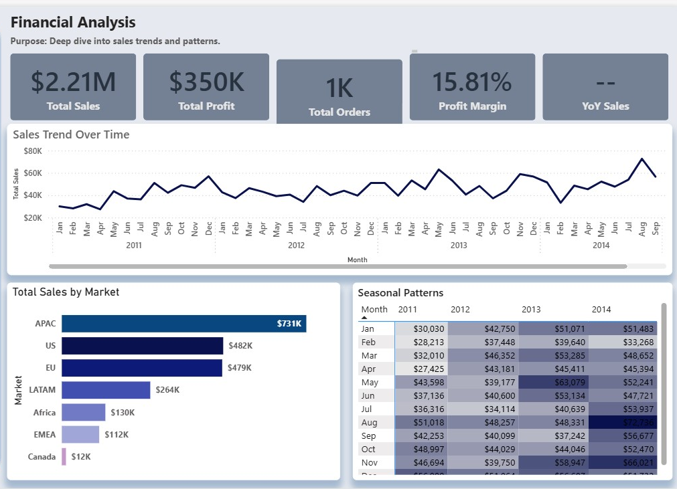
Sales Performance Overview
Key Insights:
  Steady month-over-month growth from 2011 to 2014.
  Sales increased consistently each year, with healthy YoY growth percentages.
  Seasonal trends can be identified through yearly patterns.
Visuals Shown in Dashboard:
  Sales by Month
  Seasonal Patterns
  Sales by Market

Slide 5
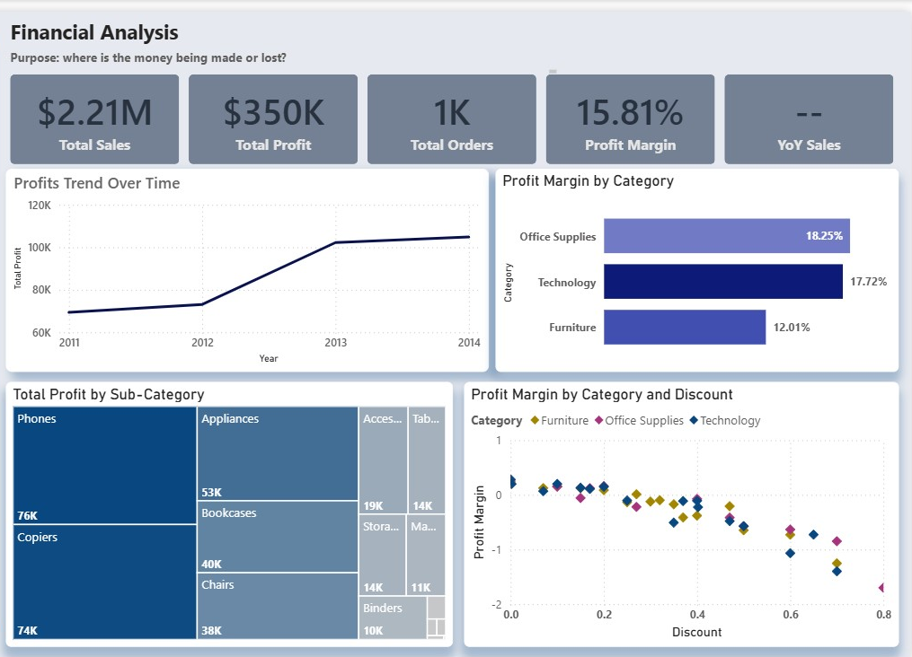
Profit & Margin Analysis
Findings:
  Profitability varies significantly across product categories and discount levels.
  Higher discount bands show reduced profit, indicating discounting inefficiency.
  Opportunities exist to refine discount strategy for certain categories.
Supporting Visuals:
  Profit vs Discount Scatter
  Profit Margin by Category

Slide 6
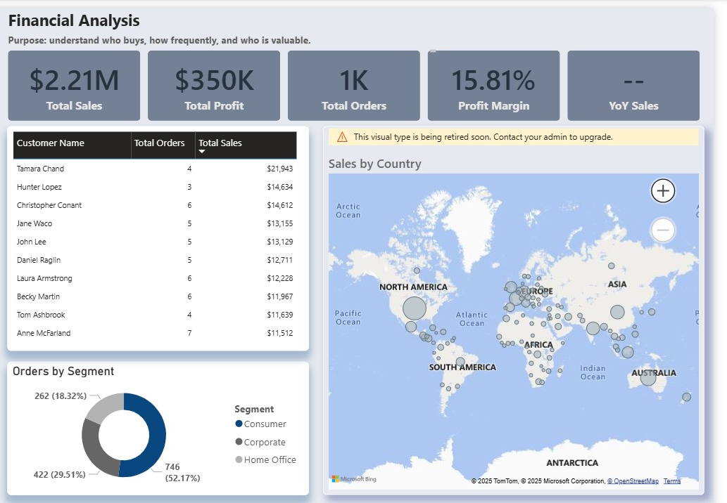
Customer Insights
Highlights:
  Customer segmentation reveals top contributing segments based on sales and profit; Consumers.
  Geographic insights show regions driving the highest performance.
  Identifying high-value customers helps align marketing and retention efforts.
Dashboard Visuals:
  Top Customers
  Segment-based Customer Distribution
  Region-wise Sales Breakdown

Slide 7
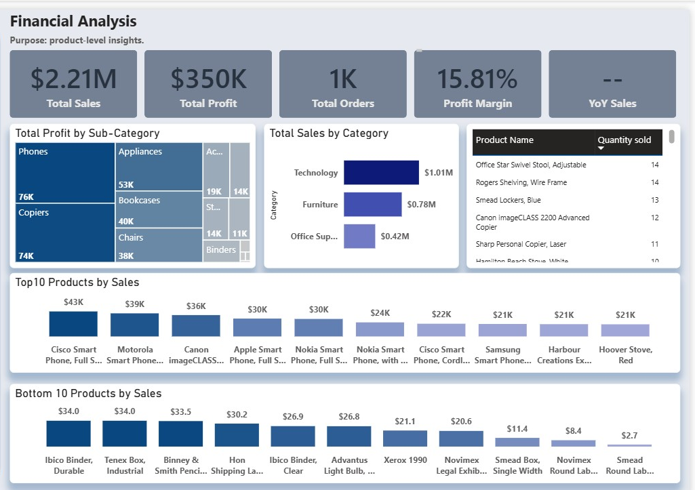
Product Performance
Key Observations:
  Certain product categories and subcategories contribute disproportionately to sales.
  Top-selling products show strong consistency across years.
  Product-level analysis supports inventory, pricing, and promotional decisions.
Supporting Visuals:
  Category/Subcategory Sales
  Top and bottom 10 Products

Slide 8
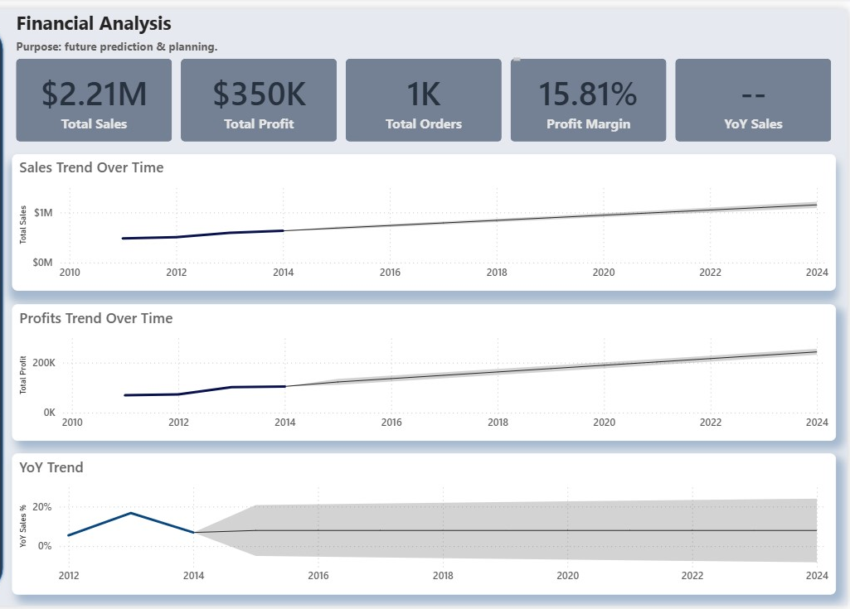
Forecasting & Future Outputs
Insights:
  Forecasting models predict continued upward sales trends under current conditions.
  Helps anticipate inventory requirements and seasonal peaks.
  Supports strategic planning and budgeting for the next financial year.
Visual Used:
  Time-Series Forecast Chart

Slide 9
Strategic Recommendation
Based on the dashboard insights:
Optimize discount policies to improve profit margins.
Invest in high-performing regions & segments for better ROI.
Stock and promote top-selling products to maintain momentum.
Leverage customer segmentation for targeted marketing.
Use forecasting insights to plan inventory and resource allocation.

